Slide 1
CSE 495B (Natural Language Processing) Lecture 9
Transformer Encoders

Slide 2
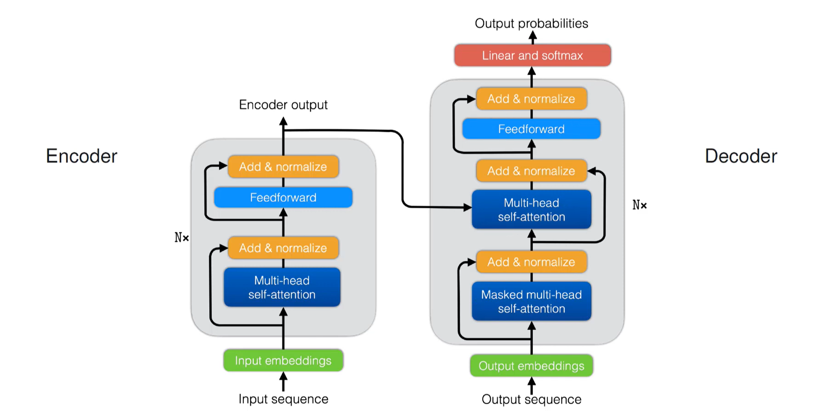
Encoder-Decoder Transformer

Slide 3
BERT use cases
Pre-train BERT (or similar encoder only language model) on a large dataset
Fine tune for the specific task using small dataset
After fine tuning BERT can handle other downstream tasks
Sentiment analysis
Document classification
Text classification, etc.
Domain specific embeddings

Slide 4
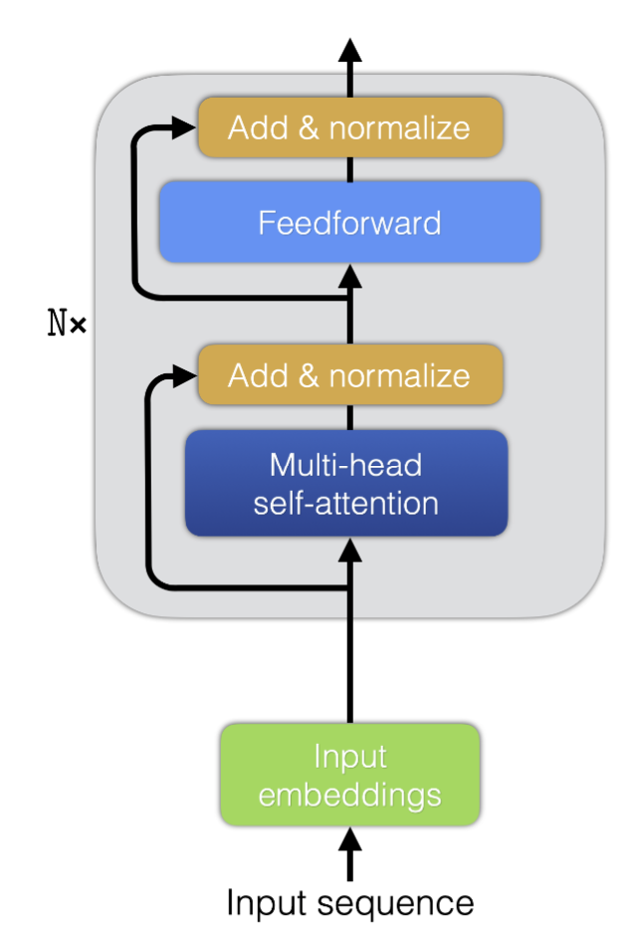
Original BERT hyperparameters
BERT is based on the transformer Encoders
There are two versions of the original BERT
BERT-BASE
N=12, d=768,h=12, #parameters=110M
Twelve layers, twelve heads, embedding size 768
BERT-LARGE
N=24, d=1024,h=16, #parameters=340M
Twenty four layers, sixteen heads, embedding size 1024

Slide 5
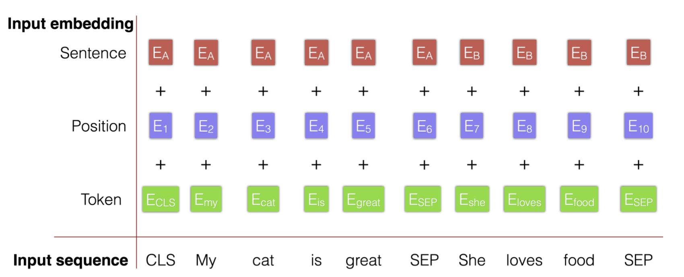
BERT Initial embedding
Input sequence: the text as input to the model
Token: initial embedding before training/forward pass
Segment/sentence: token type embedding (sentence 1 or sentence 2)
Position: the position of the token in the sequence

Slide 6
Parameter Count for BERT-base(1)
Embedding Matrices:
Word Embedding Matrix size [Vocabulary size, embedding dimension] = [30522, 768] = 23440896
Bert uses WordPiece tokenizer (vocabulary size)
The WordPiece tokenizer follows the subword tokenization scheme
Consider the sentence:
"Let us start pretraining the model.”
Tokenizing based on WordPiece algorithm we get the tokens
[let, us, start, pre, ##train, ##ing, the, model]
Position embedding matrix size, [Maximum sequence length, embedding dimension] = [512, 768] = 393216
Segment Embedding/Token Type Embedding matrix size [2, 768] = 1536
Embedding Layer Normalization, weight and Bias [768] + [768] = 1536
Total Embedding parameters = 𝟐𝟑𝟖𝟑𝟕𝟏𝟖𝟒 ≈ 𝟐𝟒𝑴

Slide 7
Parameter Count for BERT-base (2)
Attention Head:
Query Weight Matrix size [768, 64] = 49152 and Bias [64] = 64
Key Weight Matrix size [768, 64] = 49152 and Bias [64] = 64
Value Weight Matrix size [768, 64] = 49152 and Bias [64] = 64
Total parameters for one layer attention with 12 heads = 12∗(3 ∗(49152+64)) = 1771776
After concatenating the embeddings of 12 heads, a fully connected network is used
[768, 768] = 589824 and Bias [768] = 768, (589824+768 = 590592)
Then, layer Normalization layer
Weight and Bias [768], [768] = 1536
Position wise feedforward network
(1 hidden and one output) weight matrices and bias [768,3072] = 2359296, [3072] = 3072
Followed by [3072,768 ] = 2359296, [768] = 768,
Parameters for this layer (2359296+3072+ 2359296+768 = 4722432)
Another layer Normalization weight and Bias [768], [768] = 1536
Total parameters for one complete attention layer (177776 + 590592 + 1536 + 4722432 + 1536 = 7087872 ≈ 7𝑀)
Total parameters for 12 layers of attention (𝟏𝟐 ∗ 𝟕087872 = 𝟖𝟓0𝟓4464 ≈ 𝟖𝟓𝑴)

Slide 8






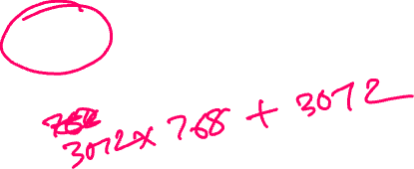


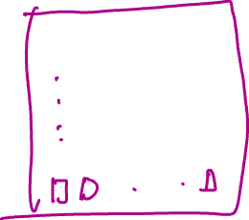










Slide 9
Parameter Count for BERT-base (3)
Output layer of BERT Encoder:
Dense Weight Matrix and Bias [768, 768] = 589824, [768] = 768, (589824 + 768 = 590592)
Total Parameters in 𝑩𝑬𝑹𝑻 𝑩ase = 𝟐𝟑𝟖𝟑𝟕𝟏𝟖𝟒 (embedding) + 𝟖𝟓054464 (attention)+ 𝟓𝟗𝟎𝟓𝟗𝟐 (classification)= 𝟏𝟎𝟗482240≈ 𝟏𝟏𝟎𝑴

Slide 10
Pre-Training Task
Does not need to be
Useful
Doesn’t need to have real-world application
Pre-training is the purpose
We will not use it for any real problem
Solvable
Model can perform poorly
It will try to solve a very hard problem
Needs to be
Unsupervised
Train the model on huge amount of data
We do not want to annotate data
We want to use as much data as possible
Difficult
Requires sophisticated understanding of language
So, it will be able to solve real-world problems
Must understand context

Slide 11
Training BERT
During training, input contains two sequences/sentences
CLS is added for classification tasks
Input embeddings are the sum of token, position and sentence embeddings.

Slide 12
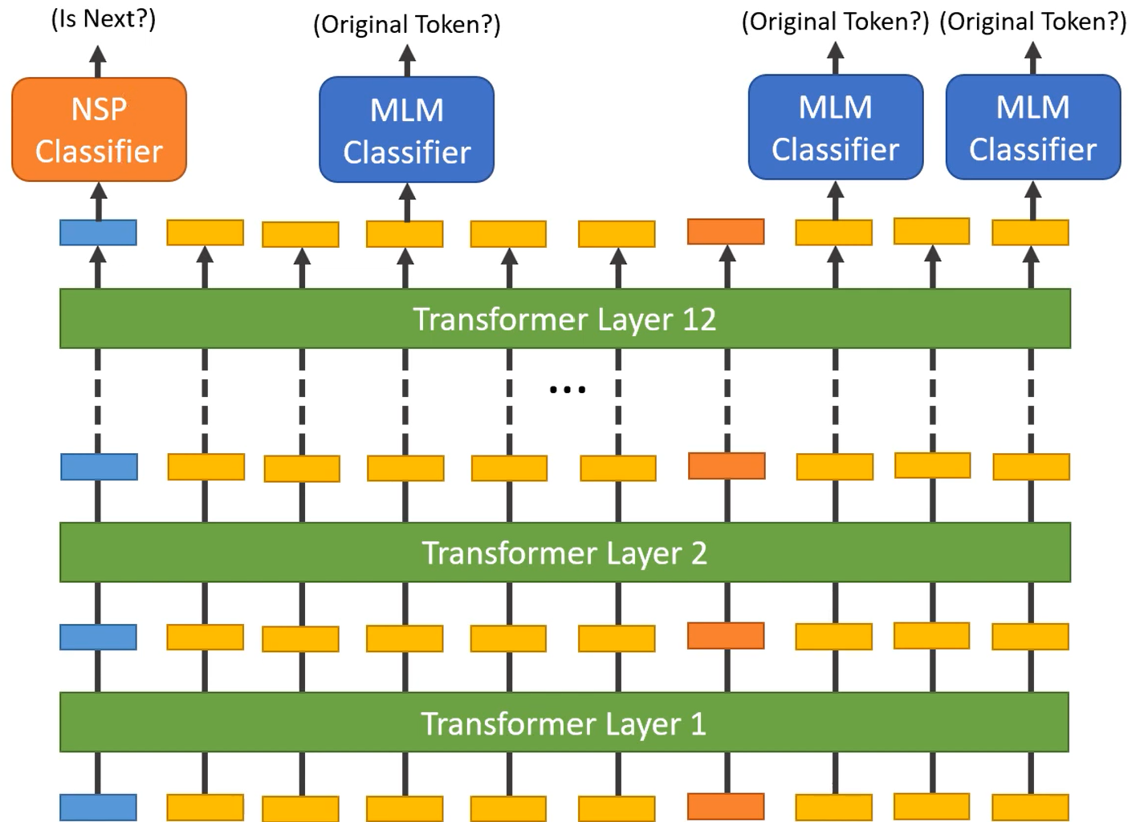
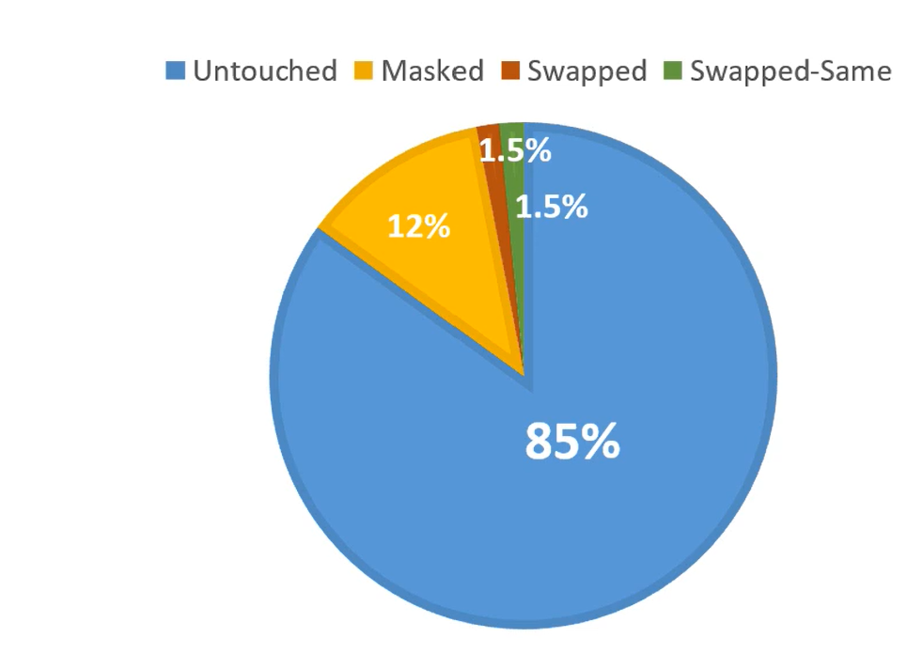
Training BERT

Slide 13
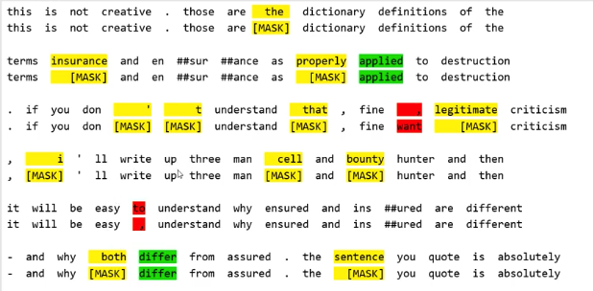
Making input ready: Token Substitution

Slide 14
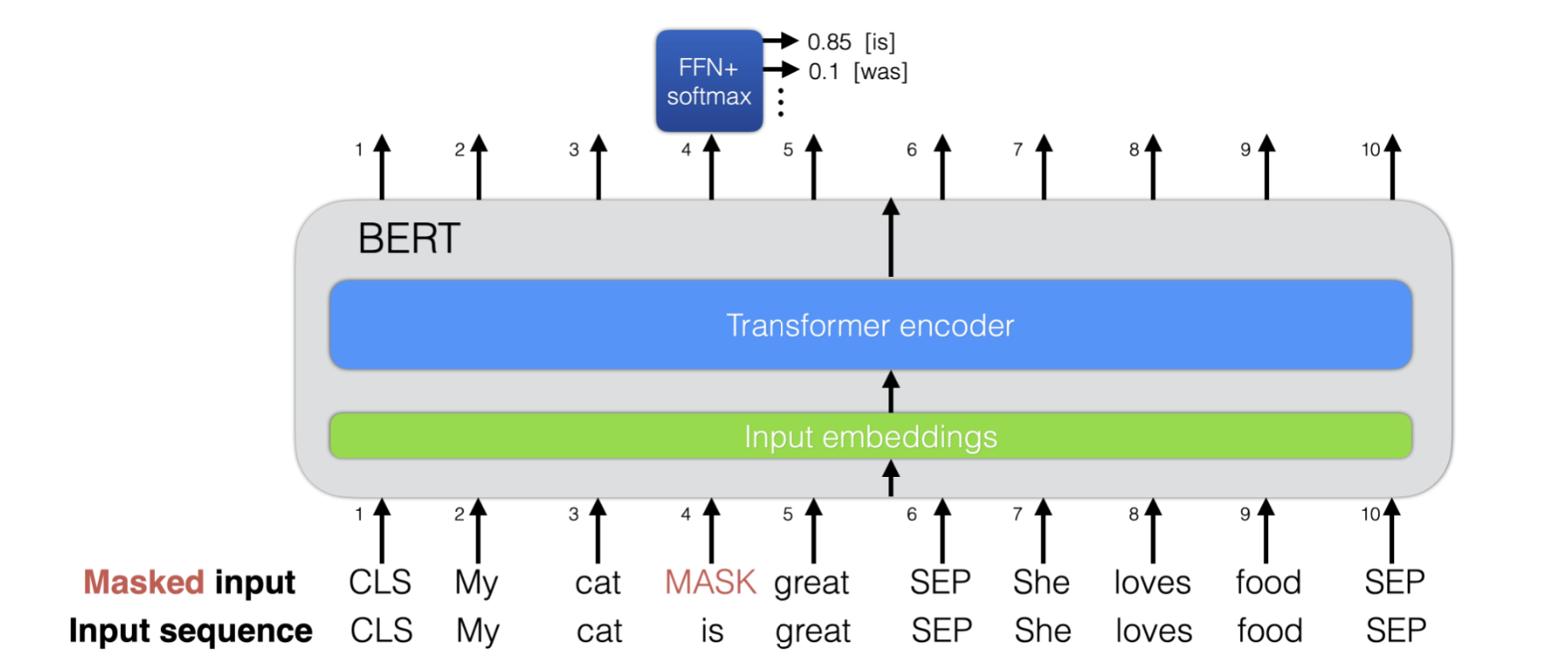
Training BERT: MASKED word prediction
First pre-training task (of two)
15% of words are masked
Predict masked word

Slide 15
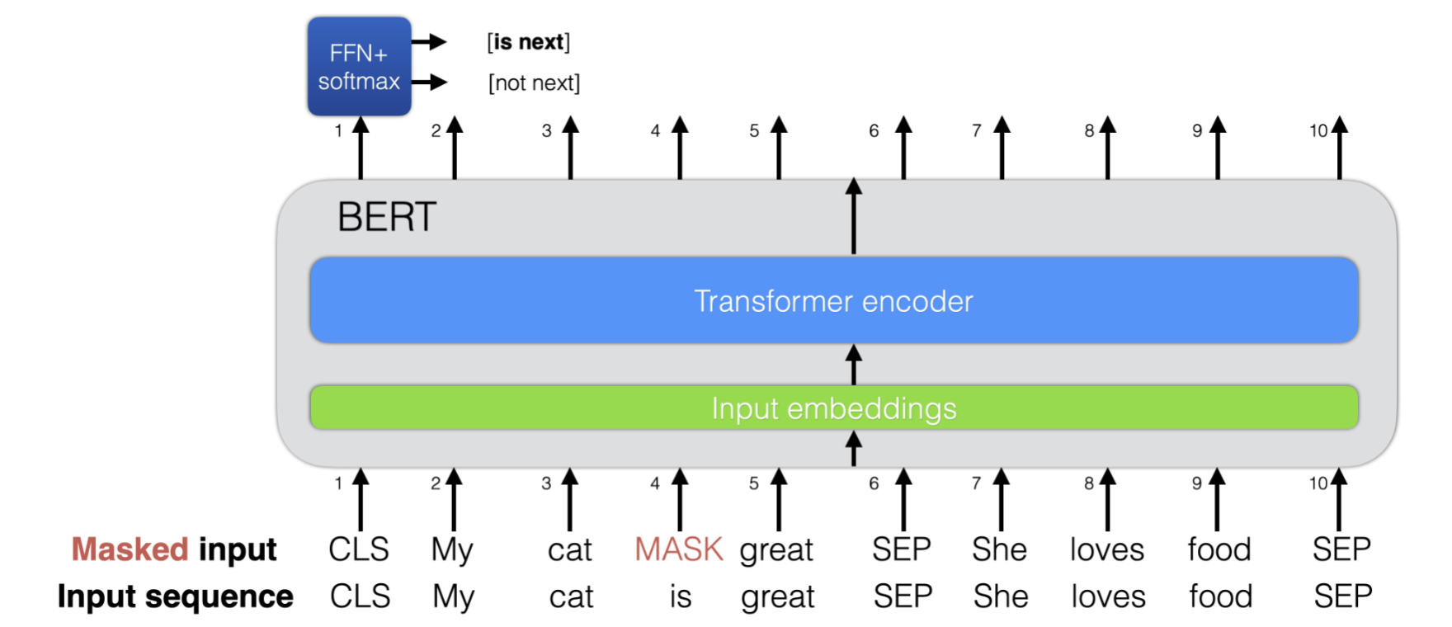
Training BERT: MASKED word prediction
Second pre-training task (of two)
Select sentence B as the sentence after A with 50%probability
Use CLS output to classify B as next/other sentence.

Slide 16
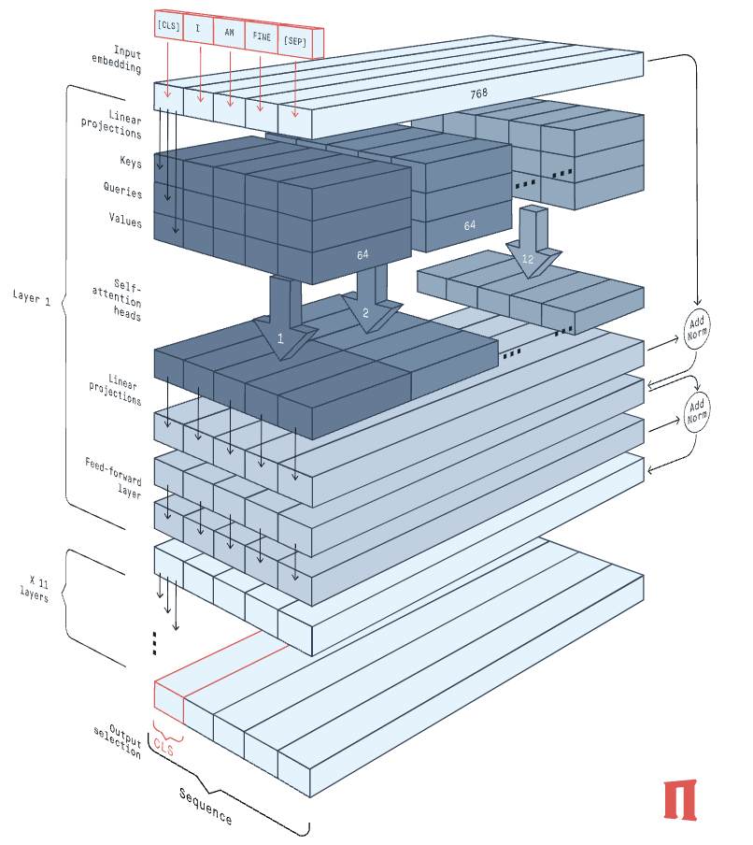
BERT Model

Slide 17
Masked language model
Masked language modelling can be considered similar to autoencoding modelling (used for word2vec)
Here auto-encoder tries to predict the corrupted input
BERT force the model to predict the masked words to complete the sentence
We can compare this type of modelling to fill in the blanks to teach kids languages
Question: what is ______ name?

Slide 18
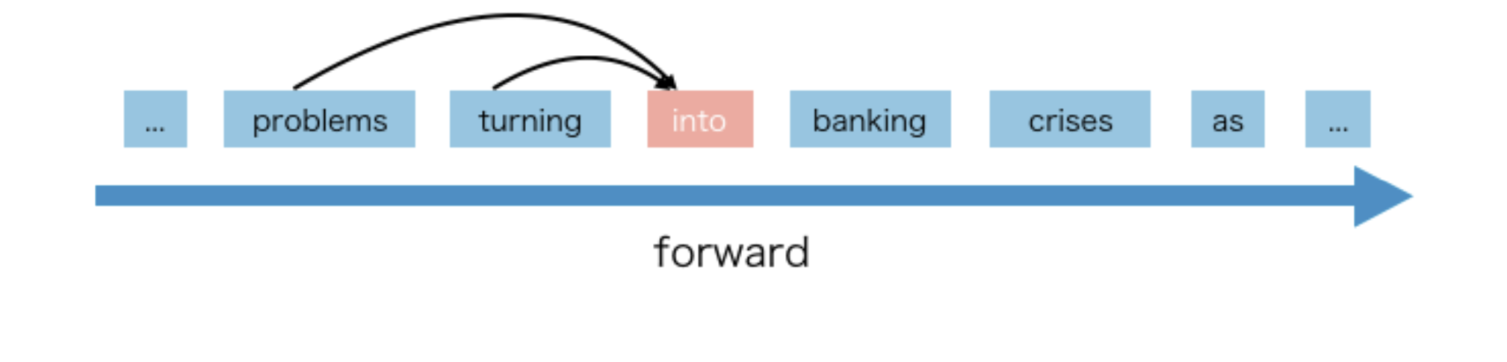
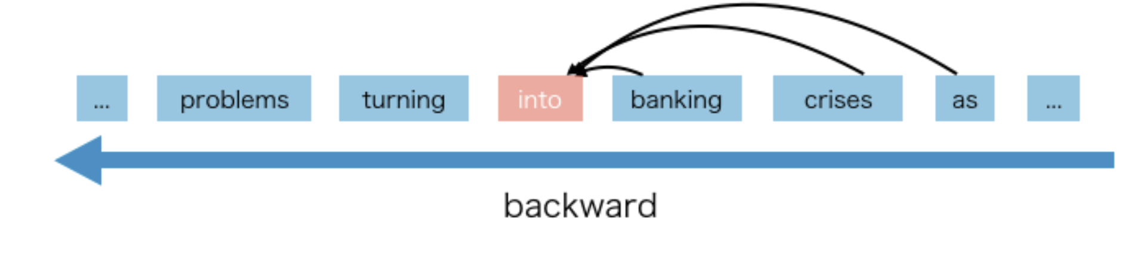
Auto-regressive (AR) training: Decoders
AR language model (unlike auto-encoders) uses the context word to predict the next word (not predicting the input)
The context words may have two directions: forward or backward
GPT (a transformer decoder) uses AR modelling

Slide 19
AR modelling pros and cons
AR language models have capabilities to generate language
For example, GPT and variants
Based on the language, the generation could be either from right to left or from left to right
However, AR language models cannot use both direction simultaneously
These models excel at language generation not in language understanding for classification tasks
Therefore, we cannot use GPT (transformer decoders) for classification tasks

Slide 20
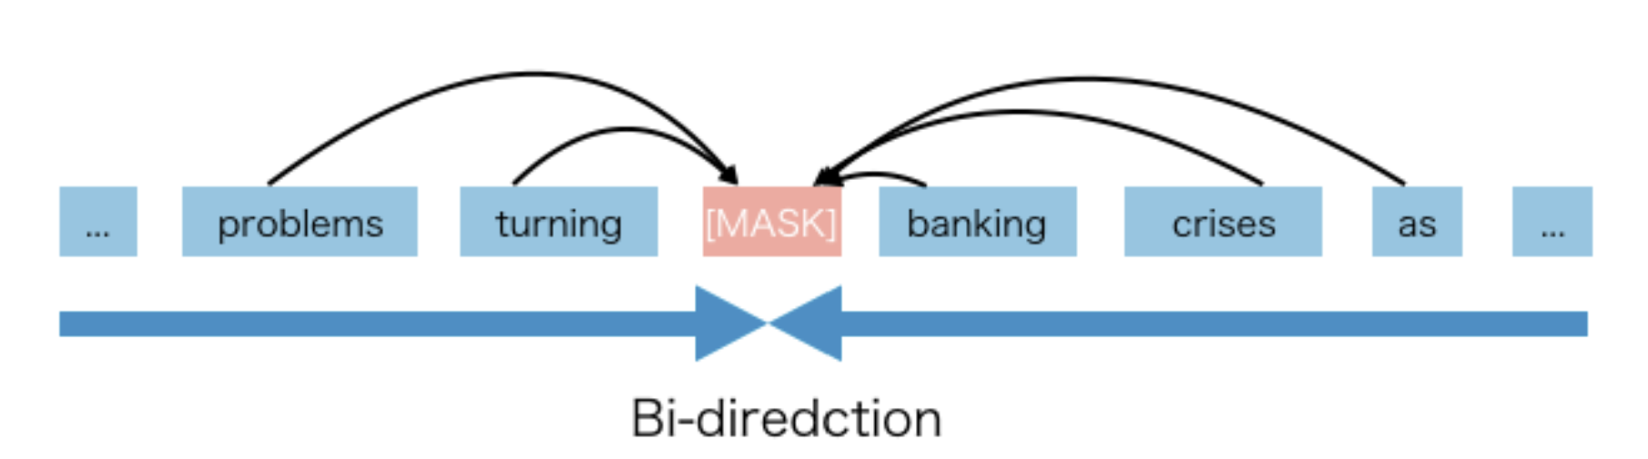
Masked vs Auto-regressive (AR) training
The AE language model tries to reconstruct the original data from corrupted (missing) input while the AR language model tries to predict the next token
BERT uses autoencoder(AE) language model for training while GPT uses AR model for training
BERT uses [MASK] and [SEP], [CLS], etc., special tokens to replace the original tokens in the pre-train phase
And the objective is to predict these missing tokens as well as find their embeddings

Slide 21
[CLS] Token
BERT encoder produces a sequence of hidden states for different words/tokens
However, for classification tasks, the entire input sequence needs to be reduced to a single vector (summarization?)
There are multiple ways of converting this sequence to a single vector representation of a sentence
Max/mean pooling or applying another neural network/attention for summarization
The BERT authors, however, went with a much simpler method:
Taking the hidden state corresponding to the first token
To make this scheme work, BERT prepends a [CLS] token (short for “classification”) to the start of each sentence
[CLS] appears at the very beginning of each sentence, it has a fixed embedding and a fix positional embedding, thus this token contains no information itself
However, the output of [CLS] is inferred by all other words in this sentence, so [CLS] contains all information in other words
This makes [CLS] a good representation for sentence-level classification
Of course, it is possible to use an average vector, it makes sense, too

Slide 22
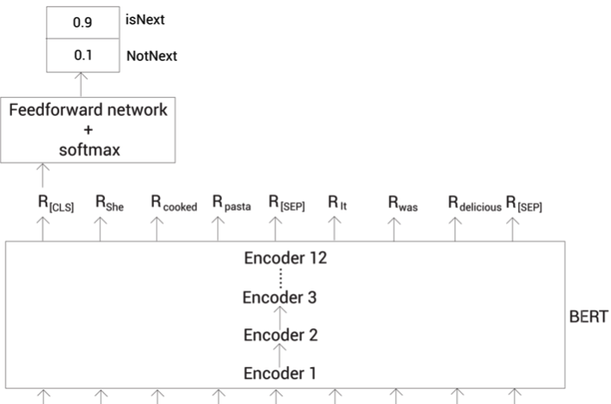
[CLS] token NSP classification (training)

Slide 23
Masked (AE) model pros and cons
AE language model can see the context in both directions: forward and backward
AE language model also has its problems
It uses the [MASK] in the pre-training, but this kind of artificial symbols are absent from the real data at fine tuning time thus causing a pre-train/fine tune discrepancy
Training and prediction tasks are different
Another problem of [MASK] is it assumes the predicted (masked) tokens are independent of each other given the unmasked tokens
Suppose we mask “banking” and “crisis” for the sentence “It shows that the housing crisis was turned into a banking crisis”
The AE modeling will consider “banking” and “crisis” as independent words and will try to find embedding with that assumption
However, “banking” and “crisis” contains implicit relation to each other
The model should learn such correlations among the predicted (masked) tokens

Slide 24
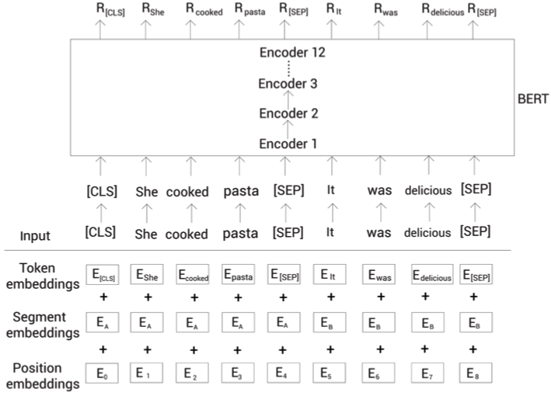
[MASK] Classification

Slide 25
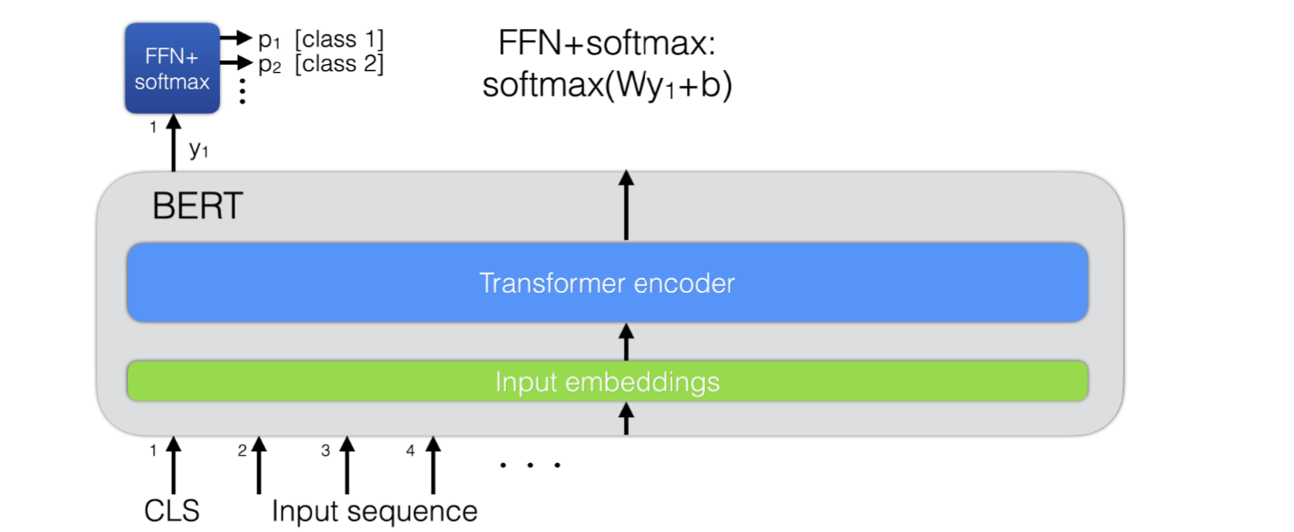
Finetuning BERT: classification
Collect annotated dataset
For sequence-level classification tasks:
Use output from CLS token for classification
Add a single layer FFN
Fine-tune end-to-end

Slide 26
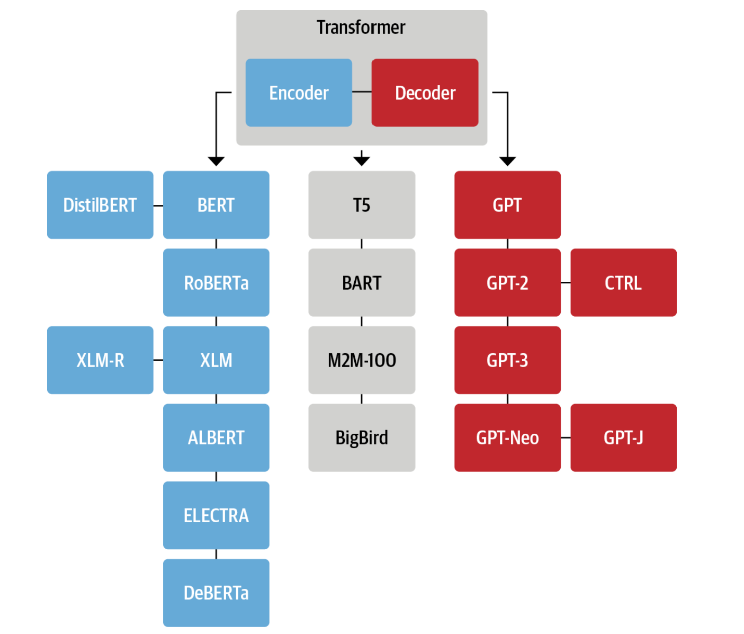
Transformer Architecture Evolution

Slide 27
The Encoder Branch
The first encoder-only model based on the Transformer encoder architecture was BERT
At the time it was published, it outperformed all the state-of-the-art models on the GLUE benchmark which measures natural language understanding (NLU) across several tasks of varying difficulty
Subsequently, the pre-training objective and the architecture of BERT have been adapted to further improve performance
Encoder-only models still dominate research and industry on NLU tasks such as text classification, named entity recognition, and question answering

Slide 28
BERT Variants
DistilBERT: Although BERT delivers great results, it’s size can make it tricky to deploy in environments where low latencies are required. By using a technique known as knowledge distillation during pretraining, DistilBERT achieves 97% of BERT’s performance while using 40% less memory and being 60% faster
It uses roughly the same general architecture as BERT, but with only 6 encoder blocks (base BERT base has 12)
These encoder blocks are also initialized by merely taking 1 out of every 2 pretrained encoder blocks of BERT
Furthermore, the token-type embeddings is also removed
Distilbert is trained using BERT as the teacher for training/distillation process, not from raw input data
RoBERTa: A study following the release of BERT revealed that its performance can be further improved by modifying the pretraining scheme. Researchers found that BERT is under-trained. RoBERTa (from meta AI) tried to fix that.

Slide 29
RoBERTa vs BERT
Training Corpus: RoBERTa is trained on a larger corpus of text compared to BERT
Dynamic Masking: RoBERTa uses a dynamic masking
Same sentence is masked multiple times
Each training epoch uses different masked sentences
No Next Sentence Prediction Loss: Unlike BERT, RoBERTa does not use a next sentence prediction (NSP) loss during pre-training. This allows RoBERTa to focus solely on the masked language modeling objective, leading to a more expressive language representation.
Large Byte-Pair Encoding Vocabulary: RoBERTa uses a larger byte-pair encoding (BPE) vocabulary size of 50k as compared to 30k size of BERT
Training Strategies: RoBERTa is trained more aggressively compared to BERT
Longer training, larger mini-batch, learning rate with schedules, etc.

Slide 30
BERT Variants: A Lite BERT (ALBERT)
Like Distilbert, Albert reduces the model size of BERT and can be trained faster
18x fewer parameters and can be trained 1.7x faster
Unlike Distilbert, however, Albert does not have a tradeoff in performance
Distilbert does have a slight tradeoff in performance as it uses BERT as the teacher model
ALBERT is trained from raw data
This comes from just the core difference in the way the Distilbert and Albert experiments are structured. Distilbert is trained in such a way to use BERT as the teacher for its training/distillation process. Albert, on the other hand, is trained from scratch like BERT. Better yet, Albert outperforms all previous models including BERT, Roberta, Distilbert, and XLNet.

Slide 31
ALBERT vs BERT
Factorized embedding parameterization: ALBERT decompose the embedding matrix into 2 small matrices to separate the size of hidden layers from embedding dimension size
It becomes possible to increase the hidden layer size without modifying embedding dimension
Reasoning: call E the embedding dimensions and H the hidden dimensions, it does not make sense to always have E = H (as BERT has).
ALBERT’s solution: call V the vocabulary size, we decompose the embedding matrix from size V * H to V * E + E * H
In particular, the embedding dimensions is reduced, and a fully-connected layer with size E * H is added after the embedding phase
Specifically, ALBERT uses the E = 128
BERT uses E = 768 for BERT_{BASE} and E = 1024 for BERT_{LARGE} and H = 4096 (compared to 768 in BERT_{BASE} and 1024 in BERT_{LARGE} )
Cross-layer parameter sharing: encoder blocks share all parameters
This reduce the parameter size
And add more regularization to the model
Also, ALBERT removes dropouts from the architecture.

Slide 32
ALBERT vs BERT (2)
Finally, the NSP objective is replaced with a sentence-ordering prediction
The model needs to predict whether or not the order of two consecutive sentences was swapped rather than predicting if they belong together at all
These (NSP and previous slide ones) changes make it possible to train even larger models with fewer parameters and reach superior performance on NLU tasks

Slide 33
BERT Variants
DeBERTa: The DeBERTa model introduces two architectural changes
First, each token is represented as two vectors: one for the content, the other for relative position. By separating the tokens’ content from their relative positions, the self-attention layers can better model the dependency of nearby token pairs
On the other hand, the absolute position of a word is also important, especially for decoding
Second, an enhanced mask decoder is used to incorporate absolute positions in the decoding layer to predict the masked tokens in model pre-training
DeBERTa is the first model (as an ensemble) to beat the human baseline on the SuperGLUE benchmark, a more difficult version of GLUE consisting of several subtasks used to measure NLU performance

